Slide 1
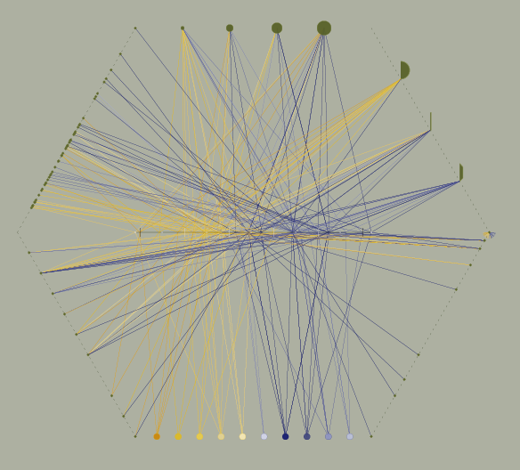
viz tank [a repository of data/info/knowledge visualisation solutions]
TimeWheel est un formalisme proposé par Tominski et al.* - une ligne de temps est combinée avec des segments sur lesquels sont portées des valeurs d’attributs.
* C. Tominski, J. Abello, and H. Schumann, “Axes-Based Visualizations with Radial Layouts,” in Proc. of ACM Symp. on Applied Computing , ACM Press, 2004, pp. 1242–1247.
Appliqué à une relecture de la classification de l’architecture de Dmochowski
Zbigniew Dmochowski
The architecture of Poland / an historical survey, (1956).
Réinterprétation du formalisme TimeWheel
J.Y. Blaise, I. Dudek (2012-2013)
J.Y. Blaise, I. Dudek, Can Infovis tools support the analysis of spatio-temporal diffusion patterns in historic architecture? , Archaeology in the Digital Era, G.Earl, et al. (Ed.), Papers from the 40th Annual Conference of Computer Applications and Quantitative Methods in Archaeology (CAA), Southampton 2012, Amsterdam University Press, Vol. II, 2013, pp. 912-925
J.Y. Blaise, I. Dudek 2021

Slide 2
viz tank [a repository of data/info/knowledge visualisation solutions]
TimeWheel est un formalisme proposé par Tominski et al.* - une ligne de temps est combinée avec des segments sur lesquels sont portées des valeurs d’attributs.
attribute axis
C. Tominski, J. Abello, and H. Schumann, “Axes-Based Visualizations with Radial Layouts,” in Proc. of ACM Symp. on Applied Computing , ACM Press, 2004, pp. 1242–1247.
Le principe
time axis
TimeWheel
C. Tominski et al. (2004)
<http://www.mgvis.com/Papers/Visualization/Greece_MMV-06.pdf>
J.Y. Blaise, I. Dudek 2021

Slide 3
viz tank [a repository of data/info/knowledge visualisation solutions]
Exemple de réutilisation possible du concept, en groupant différentes données relatives à l’organisation de conférences.
dates des conférences
2012
2014
TimeWheel
C. Tominski et al. (2004)
<http://www.mgvis.com/Papers/Visualization/Greece_MMV-06.pdf>
J.Y. Blaise, I. Dudek 2021

Slide 4
viz tank [a repository of data/info/knowledge visualisation solutions]
Exemple de réutilisation possible du concept, en groupant différentes données relatives à l’organisation de conférences.
nombre de sessions
6
8
0
dates des conférences
2012
2014
TimeWheel
C. Tominski et al. (2004)
<http://www.mgvis.com/Papers/Visualization/Greece_MMV-06.pdf>
J.Y. Blaise, I. Dudek 2021

Slide 5
viz tank [a repository of data/info/knowledge visualisation solutions]
Exemple de réutilisation possible du concept, en groupant différentes données relatives à l’organisation de conférences.
nombre de sessions
nombre de participants
8
nombre d’articles soumis
6
0
dates des conférences
2012
2014
nombre d’articles acceptés
TimeWheel
C. Tominski et al. (2004)
<http://www.mgvis.com/Papers/Visualization/Greece_MMV-06.pdf>
J.Y. Blaise, I. Dudek 2021

Slide 6
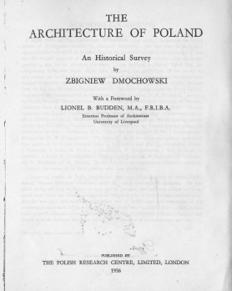
viz tank [a repository of data/info/knowledge visualisation solutions]
TimeWheel appliqué à la classification Dmochowski
(50 édifices religieux étiquetés Roman/Gothique)
the source: Z. Dmochowski, “The architecture of Poland – an historical survey” published by The Polish research centre, London 1956
the objective: show the development of architecture within the Polish state from the 10th to the 19th century
Not only a survey, a classification.
But very little indications on the division lines used.
Some hints given in the introduction:
“… the book divides the material (the edifices) according to style, but the distinctions should not be pressed too far …”.
“… It is a great help, in studying the history of architecture of any country, to know something of its political […] background … ”
“… architecture, which of all the arts is the most socially conditioned …”
Réinterprétation du formalisme TimeWheel
J.Y. Blaise, I. Dudek (2012-2013)
J.Y. Blaise, I. Dudek, Can Infovis tools support the analysis of spatio-temporal diffusion patterns in historic architecture? , Archaeology in the Digital Era, G.Earl, et al. (Ed.), Papers from the 40th Annual Conference of Computer Applications and Quantitative Methods in Archaeology (CAA), Southampton 2012, Amsterdam University Press, Vol. II, 2013, pp. 912-925
J.Y. Blaise, I. Dudek 2021

Slide 7
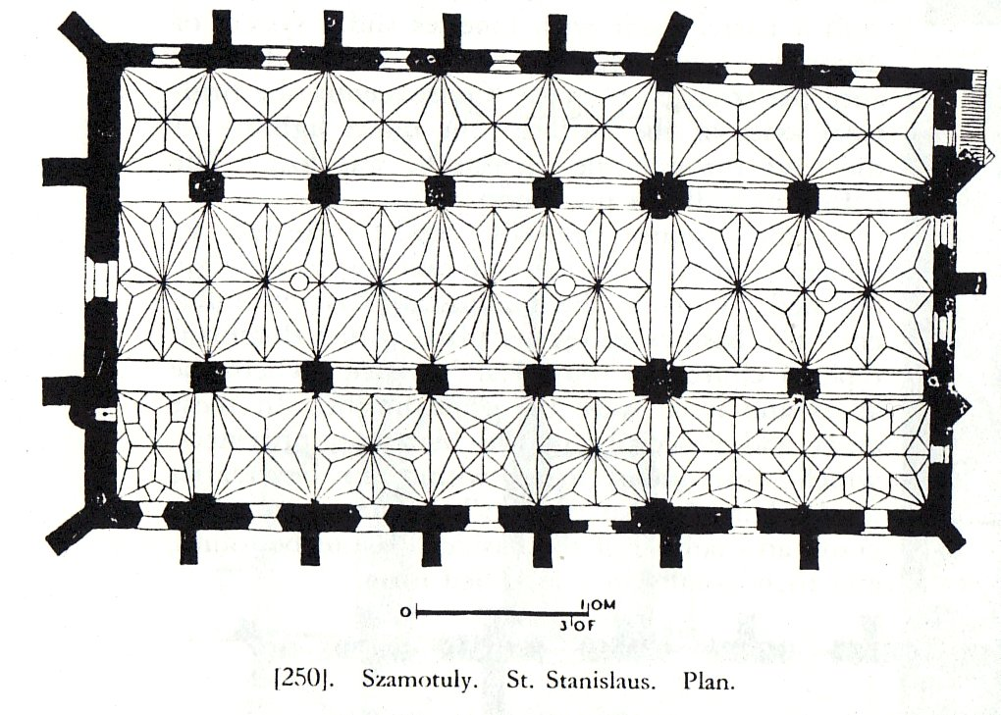
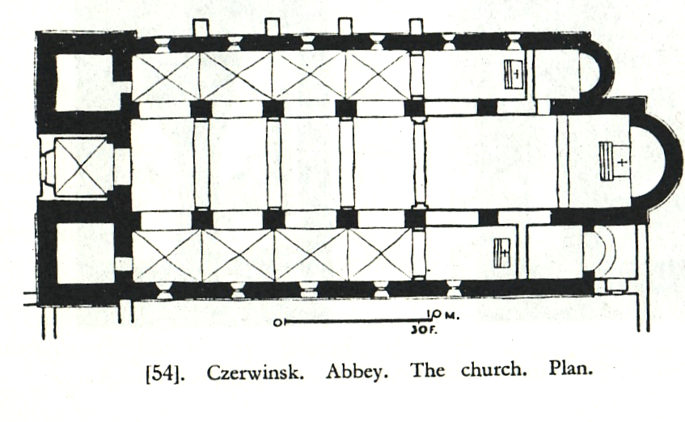
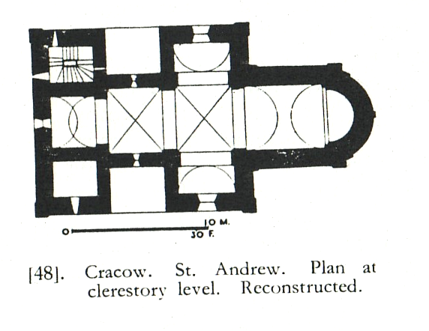
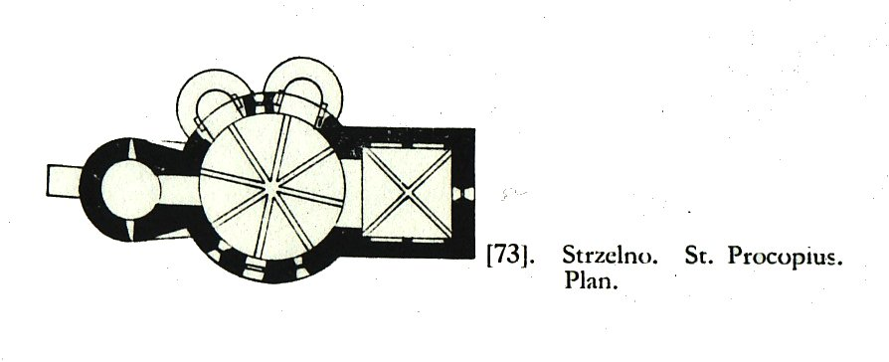
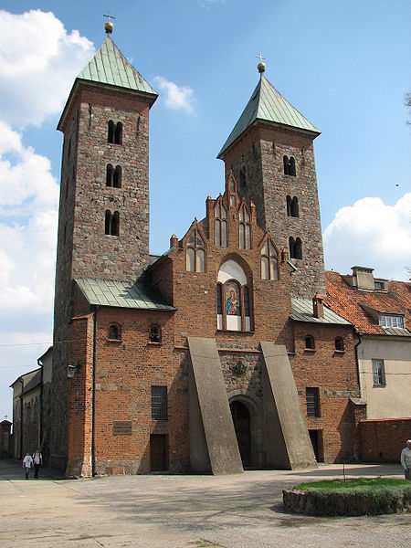
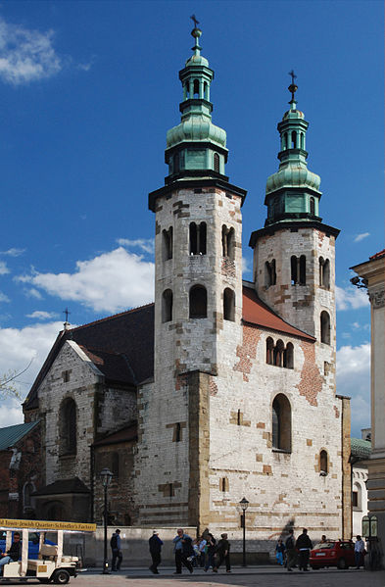
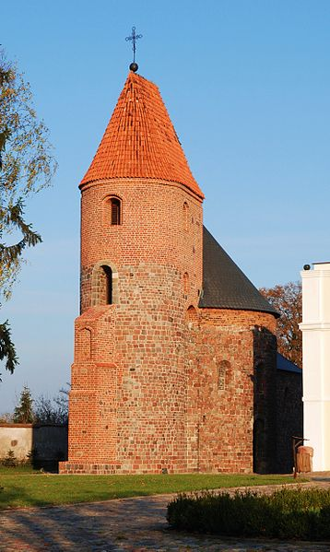
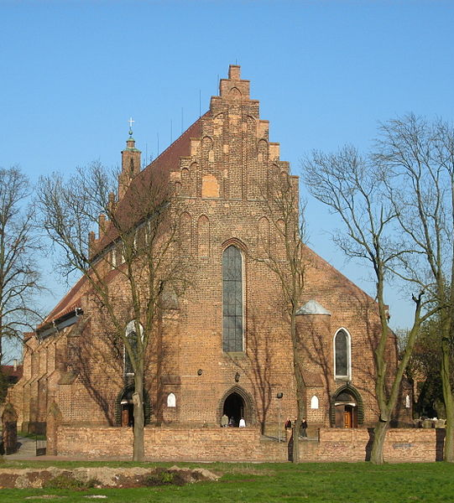
viz tank [a repository of data/info/knowledge visualisation solutions]
TimeWheel appliqué à la classification Dmochowski
A survey, a classification of individual edifices.
Plans from Dmochowski’s book
Images from Wikipedia
J.Y. Blaise, I. Dudek 2021

Slide 8
viz tank [a repository of data/info/knowledge visualisation solutions]
TimeWheel appliqué à la classification Dmochowski
> First step of the classification : styles as the main division line
Romanesque
Gothic
Renaissance
J.Y. Blaise, I. Dudek
J.Y. Blaise, I. Dudek 2021

Slide 9
viz tank [a repository of data/info/knowledge visualisation solutions]
TimeWheel appliqué à la classification Dmochowski
> Second step : use / destination
Romanesque secular architecture
Romanesque
Romanesque ecclesiastical architecture
Gothic
Renaissance
J.Y. Blaise, I. Dudek 2021

Slide 10
viz tank [a repository of data/info/knowledge visualisation solutions]
TimeWheel appliqué à la classification Dmochowski
> Third step : a classification by general architectural composition / choices
Romanesque
Group 2: Basilican churches with transept
Group 3: Basilican churches without transept
Group 4: Single cell circular churches
Gothic
Renaissance
Each group is a chapter inside which several edifices are described.
J.Y. Blaise, I. Dudek 2021

Slide 11
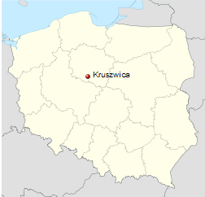
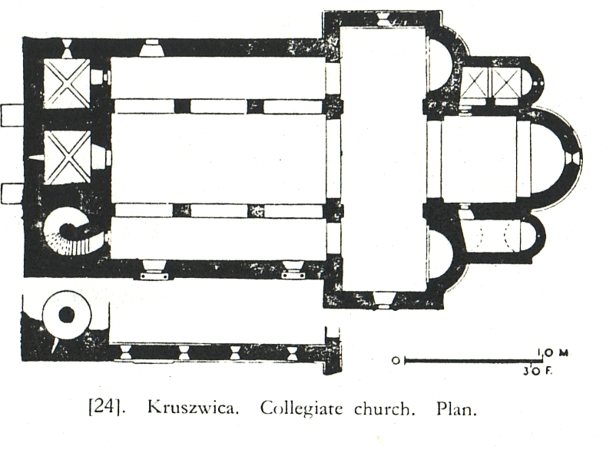
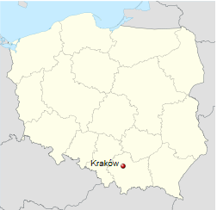
viz tank [a repository of data/info/knowledge visualisation solutions]
TimeWheel appliqué à la classification Dmochowski
> Three clear steps : style, use, +- architectural composition
> Another, underlying step : space and time, not used as division lines, but present in the
author’s introduction
1000
1200
Romanesque / ecclesiastical architecture
Group 2: Basilican churches with transept
1000
1200
J.Y. Blaise, I. Dudek 2021

Slide 12
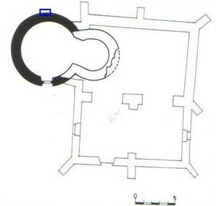
viz tank [a repository of data/info/knowledge visualisation solutions]
TimeWheel appliqué à la classification Dmochowski
> Three clear steps : style, use, +- architectural composition
> Another, underlying step : space and time, not used as division lines, but present in the
author’s introduction
However indications given by Z. Dmochowski are hereterogeneous:
12th century
1000
1200
Romanesque / ecclesiastical architecture
Group 2: Basilican churches with transept
1086
1000
1200
The variability differs from group to group.
J.Y. Blaise, I. Dudek 2021

Slide 13
viz tank [a repository of data/info/knowledge visualisation solutions]
TimeWheel appliqué à la classification Dmochowski
Our goal: not an exhaustive analysis of the survey, or of Polish architecture,
but more like a proof feasibility experiment.
The experiment was carried out on a subset : 50 edifices, 2 styles (Romanesque /Gothic) 10 groups, time and space , plus a subjective selection of features – step 5.
Group 2: basilican churches with transept
Group 9: early churches of the mendicant
/preaching orders
Group 3: basilican churches without transept
Group 10: basilican churches
Romanesque ecclesiastical architecture
Group 4: single cell circular churches
Group 11: Three nave hall churches
Gothic ecclesiastical architecture
Group 5: single cell rectangular cell
Group 12: Double-nave hall churches
Group 6: Cistercian churches and monasteries
Group 13: Single-nave hall churches
J.Y. Blaise, I. Dudek 2021

Slide 14
viz tank [a repository of data/info/knowledge visualisation solutions]
TimeWheel appliqué à la classification Dmochowski
> Three clear steps : style, use, +- architectural composition
> Another, underlying step : space and time, not used as division lines, but present in the
author’s introduction
> A fifth step – an interpretation step: architectural features, corresponding to heterogeneous
variables
length
shape of the apse
number of chapels
number of interior volumes
float or integer
lexical scale
numerical scale
numerical scale
Romanesque / ecclesiastical architecture
Group 2: Basilican churches with transept
Indications not systematically present in the Dmochowski’s survey.
J.Y. Blaise, I. Dudek 2021

Slide 15
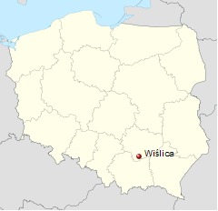
viz tank [a repository of data/info/knowledge visualisation solutions]
TimeWheel appliqué à la classification Dmochowski
Eight variables to combine : an example
style : gothic
group : Double-nave hall churches
foundation : 1350
Max. length : 51,1 m
Volumes: 3
Apse: round
Number of chapels : 0
style
group
foundation date
localisation (2D coordinates)
length
shape of the apse
number of chapels
number of interior volumes
length (approx.)
J.Y. Blaise, I. Dudek 2021

Slide 16
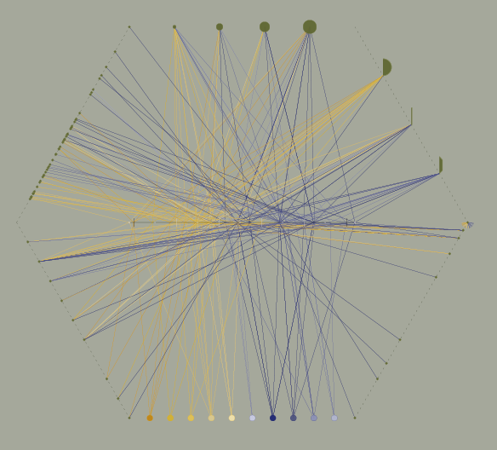
viz tank [a repository of data/info/knowledge visualisation solutions]
Each of the 50 edifices is represented by a series of connections between the time axis and the attributes axes
Oldest edifice in the collection
Newest edifice in the collection
fondation dates
Réinterprétation du formalisme TimeWheel
J.Y. Blaise, I. Dudek (2012-2013)
J.Y. Blaise, I. Dudek 2021

Slide 17
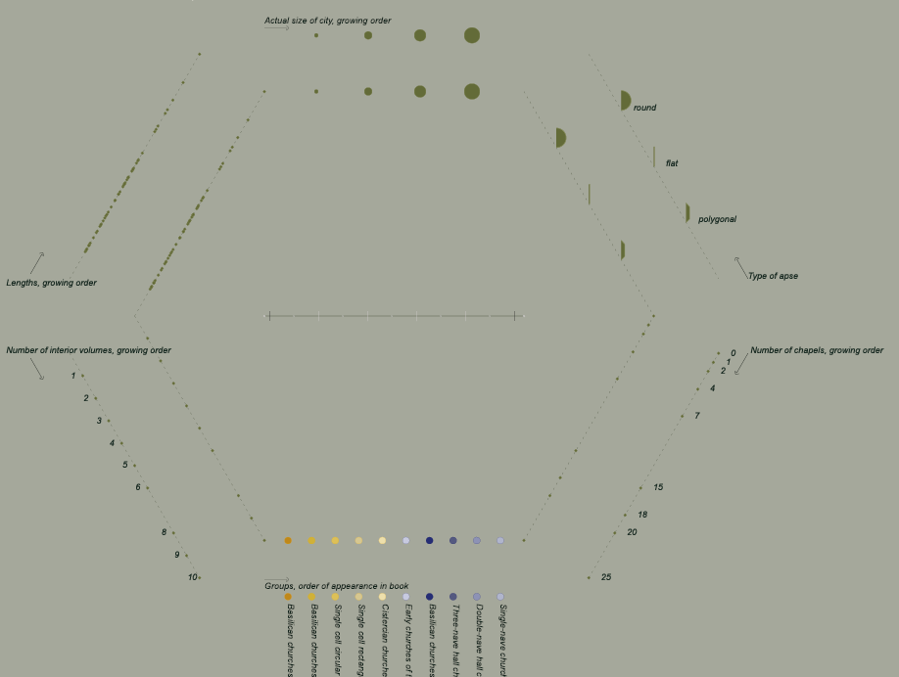
viz tank [a repository of data/info/knowledge visualisation solutions]
Lenghts
quantity
Size of city today
numerical scale
Type of apse
lexical scale
Group
lexical scale
Number of chapels
quantity
Number of interior volumes
quantity
J.Y. Blaise, I. Dudek 2021

Slide 18
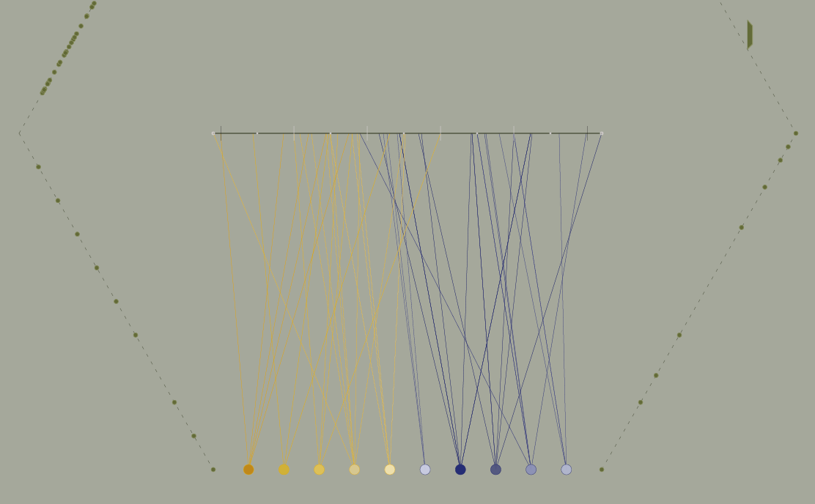
viz tank [a repository of data/info/knowledge visualisation solutions]
Observations made possible.
overlapping of styles
timeline
groups
Dmochowski’s classification is time-oriented
J.Y. Blaise, I. Dudek 2021

Slide 19
viz tank [a repository of data/info/knowledge visualisation solutions]
Observations made possible.
expected pattern
exception
expected pattern
Réinterprétation du formalisme TimeWheel
J.Y. Blaise, I. Dudek (2012-2013)
J.Y. Blaise, I. Dudek 2021

Slide 20
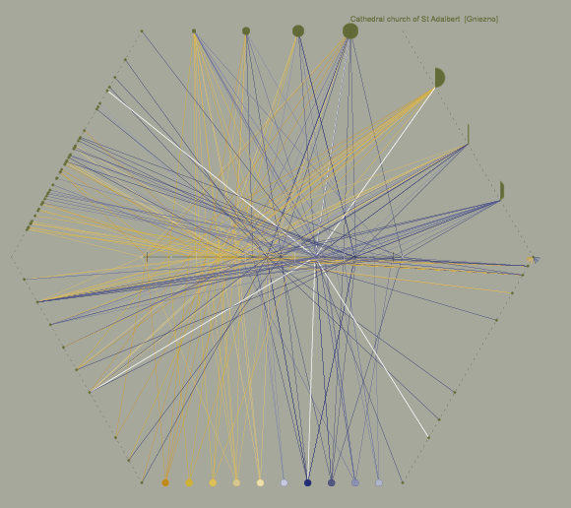
viz tank [a repository of data/info/knowledge visualisation solutions]
Observations made possible.
exception
exception
Réinterprétation du formalisme TimeWheel
J.Y. Blaise, I. Dudek (2012-2013)
J.Y. Blaise, I. Dudek 2021

Slide 21
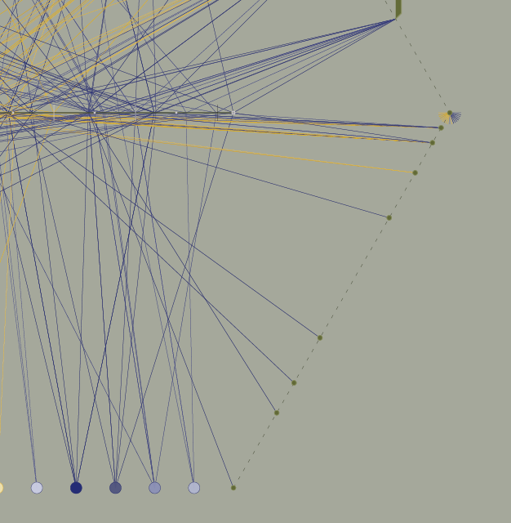
viz tank [a repository of data/info/knowledge visualisation solutions]
Observations made possible.
Number of chapels
Value “zero” occurs almost in every group and style
The formalism helps analysing the value of a given variable
(here number of chapels) over the whole collection.
High values always occur inside the same 2 groups : basilican churches and three-nave hall churches
Réinterprétation du formalisme TimeWheel
J.Y. Blaise, I. Dudek (2012-2013)
J.Y. Blaise, I. Dudek 2021

