Slide 1
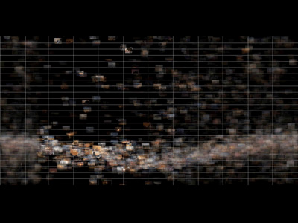
viz tank [a repository of data/info/knowledge visualisation solutions]
15000 photos tagged with the word "sunset", taken throughout 2004.
Their horizontal positions represent the day of the year the photo was taken. January is on the left, December is on the right. The vertical bars are the boundaries between months.
The vertical position represents the time of day the photo was taken, according to the EXIF data. The horizontal lines are hours, with the thick line in the middle representing 12 noon.
http://www.infovis.info/visuals/visualcomplexity/entry87image1.jpg
Time Graphs: Sunsets by time
Jim Bumgardner (2005)
<http://www.visualcomplexity.com/vc/project.cfm?id=87>
J.Y. Blaise, I. Dudek 2021

Slide 2
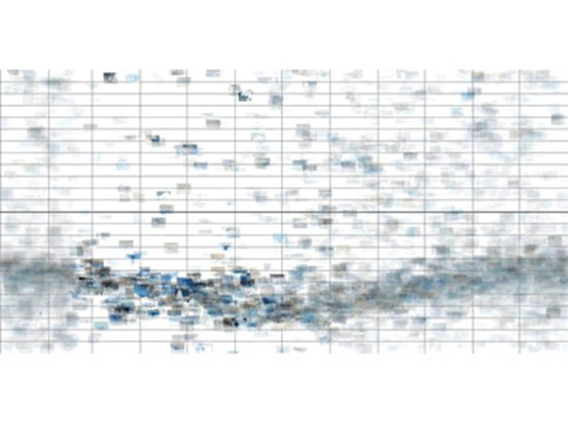
viz tank [a repository of data/info/knowledge visualisation solutions]
Janvier
Décembre
Time Graphs: Sunsets by time
Jim Bumgardner (2005)
<http://www.visualcomplexity.com/vc/project.cfm?id=87>
J.Y. Blaise, I. Dudek 2021

Slide 3
viz tank [a repository of data/info/knowledge visualisation solutions]
12:00
heures
20:00
Time Graphs: Sunsets by time
Jim Bumgardner (2005)
<http://www.visualcomplexity.com/vc/project.cfm?id=87>
J.Y. Blaise, I. Dudek 2021

Slide 4
viz tank [a repository of data/info/knowledge visualisation solutions]
Juin
The deepest "dip" in the wave formed by the images is the Summer Solstice.
Time Graphs: Sunsets by time
Jim Bumgardner (2005)
<http://www.visualcomplexity.com/vc/project.cfm?id=87>
J.Y. Blaise, I. Dudek 2021

