Slide 1
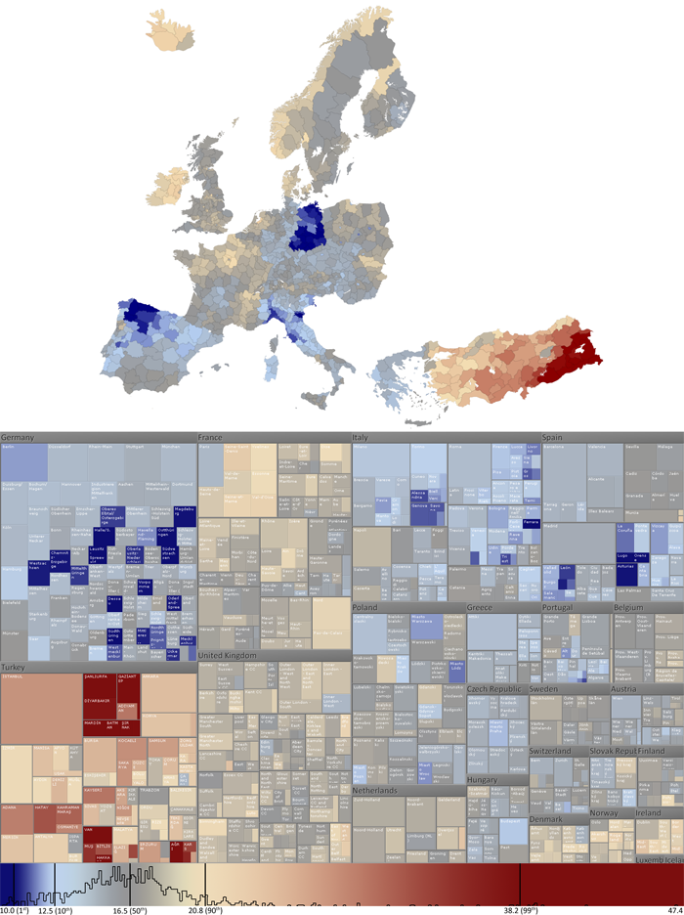
viz tank [a repository of data/info/knowledge visualisation solutions]
Démographie (espace, quantités)
Ratio of children in the European OECD member countries. The colour of each region represents the percentage of the total population that falls within the 0-14 age group.
Size in the Treemap shows the size of the total population.
Treemap - Ratio of children in the European OECD member countries
Sara Johansson (c. 2010)
<http://ncva.itn.liu.se/research?l=en>
J.Y. Blaise, I. Dudek 2021

Slide 2
viz tank [a repository of data/info/knowledge visualisation solutions]
Démographie (espace, quantités)
Un rectangle = un pays, redécoupé en régions.
Taille du rectangle « pays » et des sous-rectangles = population
Treemap - Ratio of children in the European OECD member countries
Sara Johansson (c. 2010)
<http://ncva.itn.liu.se/research?l=en>
J.Y. Blaise, I. Dudek 2021

Slide 3
viz tank [a repository of data/info/knowledge visualisation solutions]
Démographie (espace, quantités)
Tendances inverses entre pays
Treemap - Ratio of children in the European OECD member countries
Sara Johansson (c. 2010)
<http://ncva.itn.liu.se/research?l=en>
J.Y. Blaise, I. Dudek 2021

Slide 4
viz tank [a repository of data/info/knowledge visualisation solutions]
Démographie (espace, quantités)
Contrastes à l’intérieur d’un pays
Treemap - Ratio of children in the European OECD member countries
Sara Johansson (c. 2010)
<http://ncva.itn.liu.se/research?l=en>
J.Y. Blaise, I. Dudek 2021

