Slide 1
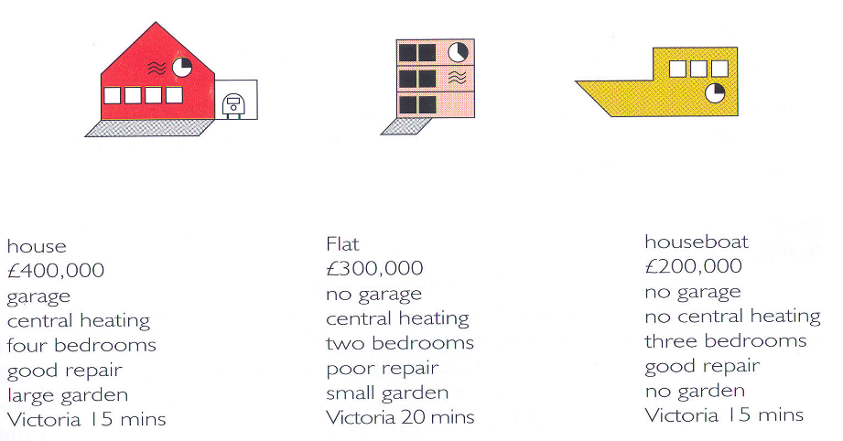
viz tank [a repository of data/info/knowledge visualisation solutions]
Multidimensional icons
R. Spence (2001)
An icon summarising the values of several heterogeneous variables for a given item in a collection.
[in] R. Spence, Information Visualisation, Addision-Wesley 2001
J.Y. Blaise, I. Dudek 2021

Slide 2
viz tank [a repository of data/info/knowledge visualisation solutions]
shape of an icon
type
Multidimensional icons
R. Spence (2001)
Categorical data (nominal).
< https://www.formpl.us/blog/categorical-data >
[in] R. Spence, Information Visualisation, Addision-Wesley 2001
J.Y. Blaise, I. Dudek 2021

Slide 3
viz tank [a repository of data/info/knowledge visualisation solutions]
colour
rent
Multidimensional icons
R. Spence (2001)
Quantitative data.
[in] R. Spence, Information Visualisation, Addision-Wesley 2001
J.Y. Blaise, I. Dudek 2021

Slide 4
viz tank [a repository of data/info/knowledge visualisation solutions]
pictogram
garage
Multidimensional icons
R. Spence (2001)
Boolean (~categorical).
[in] R. Spence, Information Visualisation, Addision-Wesley 2001
J.Y. Blaise, I. Dudek 2021

Slide 5
viz tank [a repository of data/info/knowledge visualisation solutions]
pictogram
heating
Multidimensional icons
R. Spence (2001)
Boolean (~categorical).
[in] R. Spence, Information Visualisation, Addision-Wesley 2001
J.Y. Blaise, I. Dudek 2021

Slide 6
viz tank [a repository of data/info/knowledge visualisation solutions]
number of windows
number of bedrooms
Multidimensional icons
R. Spence (2001)
Quantitative data.
( could be seen as ordinal data)
[in] R. Spence, Information Visualisation, Addision-Wesley 2001
J.Y. Blaise, I. Dudek 2021

Slide 7
viz tank [a repository of data/info/knowledge visualisation solutions]
colour of windows
state of the object
Multidimensional icons
R. Spence (2001)
Categorical data (ordinal).
< https://www.formpl.us/blog/categorical-data >
[in] R. Spence, Information Visualisation, Addision-Wesley 2001
J.Y. Blaise, I. Dudek 2021

Slide 8
viz tank [a repository of data/info/knowledge visualisation solutions]
Presence / size
of a grey trapezium
(parallelogram)
garden
Multidimensional icons
R. Spence (2001)
Categorical data (ordinal).
< https://www.formpl.us/blog/categorical-data >
[in] R. Spence, Information Visualisation, Addision-Wesley 2001
J.Y. Blaise, I. Dudek 2021

Slide 9
viz tank [a repository of data/info/knowledge visualisation solutions]
clock face
proximity of a railway station
Multidimensional icons
R. Spence (2001)
Quantitative (time-oriented) data.
[in] R. Spence, Information Visualisation, Addision-Wesley 2001
J.Y. Blaise, I. Dudek 2021

