Slide 1
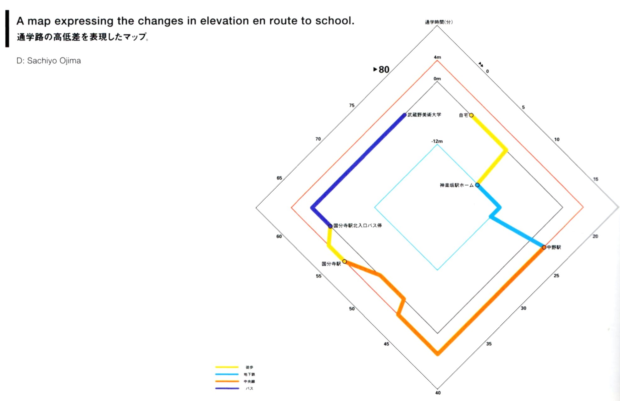
viz tank [a repository of data/info/knowledge visualisation solutions]
Altitudes (différences en élévation par rapport au point de départ)
Segments du parcours
Home to school diagram – changes in elevation
S. Ojima (2009)
[dans] Informational diagrams PIE books 2010
Diagram Design Course / Department of Visual Communication Design / Musashino Art University
J.Y. Blaise, I. Dudek 2021

Slide 2
viz tank [a repository of data/info/knowledge visualisation solutions]
Home to school diagram – changes in elevation
S. Ojima (2009)
[dans] Informational diagrams PIE books 2010
Diagram Design Course / Department of Visual Communication Design / Musashino Art University
J.Y. Blaise, I. Dudek 2021

