Slide 1
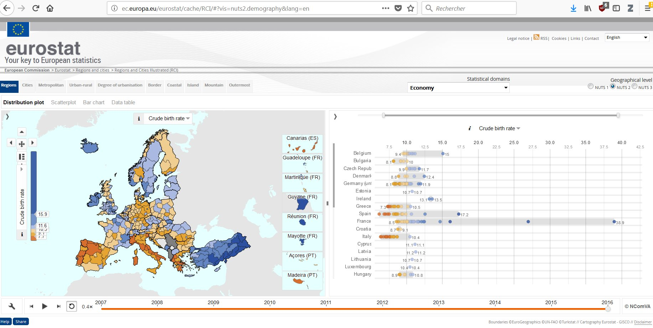
viz tank [a repository of data/info/knowledge visualisation solutions]
Crude birth rate*, multiple view (cartography + distribution plot).
Data per region.
*The crude birth rate is the number of live births occurring among the population of a given geographical area during a given year, per 1,000 mid-year total population of the given geographical area during the same year.
Source: OCDE glossary of statistical terms <https://stats.oecd.org/glossary/detail.asp?ID=490>
Eurostat Regional Statistics Illustrated
NComVA (2018)
<http://epp.eurostat.ec.europa.eu/cache/RSI/>
<http://ec.europa.eu/eurostat/cache/RCI/#?vis=nuts2.demography&lang=en>
<http://ncva.itn.liu.se/research?l=en>
J.Y. Blaise, I. Dudek 2021

Slide 2
viz tank [a repository of data/info/knowledge visualisation solutions]
Statistiques “par régions”
> Observer la variabilité de leurs surfaces
France, Espagne, valeurs divergentes mais même tendance à des constrastes entre regions (répartition “étirée” des points)
Crude birth rate*, multiple view (cartography + distribution plot).
Data per region.
*The crude birth rate is the number of live births occurring among the population of a given geographical area during a given year, per 1,000 mid-year total population of the given geographical area during the same year.
Source: OCDE glossary of statistical terms <https://stats.oecd.org/glossary/detail.asp?ID=490>
Eurostat Regional Statistics Illustrated
NComVA (2018)
<http://epp.eurostat.ec.europa.eu/cache/RSI/>
<http://ec.europa.eu/eurostat/cache/RCI/#?vis=nuts2.demography&lang=en>
<http://ncva.itn.liu.se/research?l=en>
J.Y. Blaise, I. Dudek 2021

Slide 3
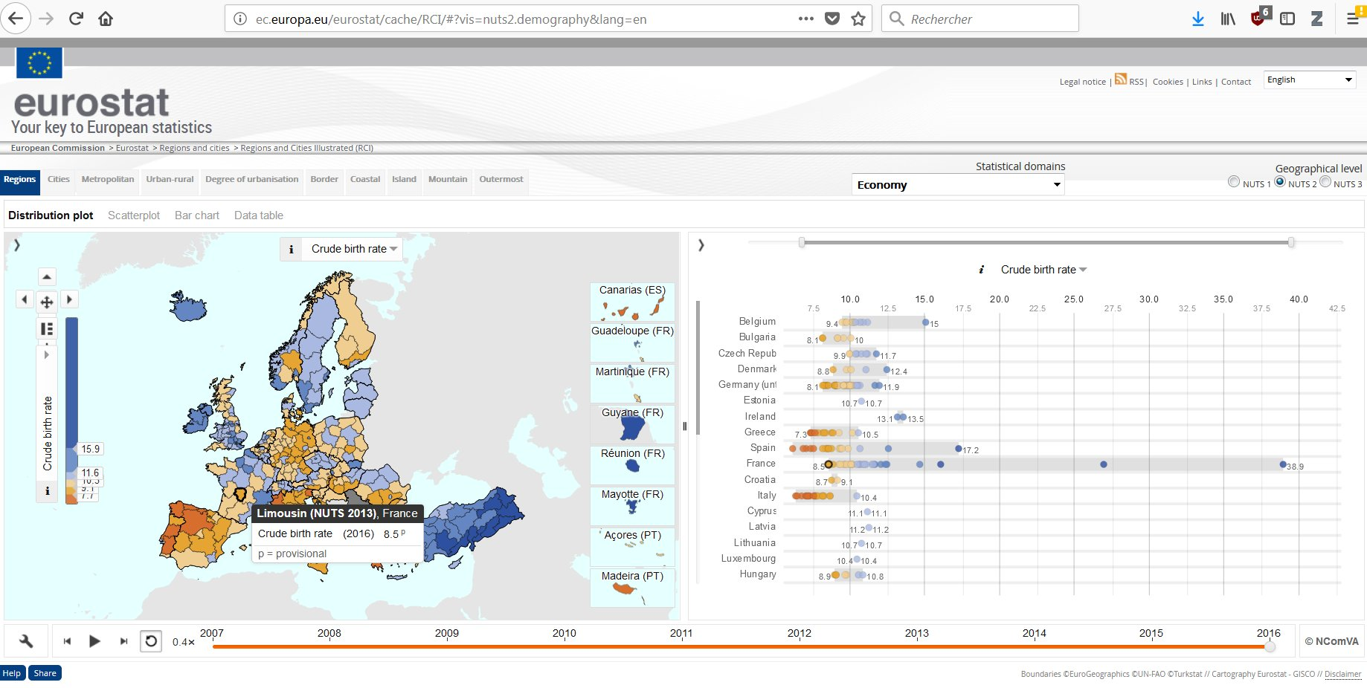
viz tank [a repository of data/info/knowledge visualisation solutions]
France,
Identification / localisation du taux le plus faible
Crude birth rate*, multiple view (cartography + distribution plot).
Data per region.
*The crude birth rate is the number of live births occurring among the population of a given geographical area during a given year, per 1,000 mid-year total population of the given geographical area during the same year.
Source: OCDE glossary of statistical terms <https://stats.oecd.org/glossary/detail.asp?ID=490>
Eurostat Regional Statistics Illustrated
NComVA (2018)
<http://epp.eurostat.ec.europa.eu/cache/RSI/>
<http://ec.europa.eu/eurostat/cache/RCI/#?vis=nuts2.demography&lang=en>
<http://ncva.itn.liu.se/research?l=en>
J.Y. Blaise, I. Dudek 2021

Slide 4
viz tank [a repository of data/info/knowledge visualisation solutions]
France,
Des maxima trés divergents du “cluster” national, et trés supérieurs au reste des pays européens.
Crude birth rate*, multiple view (cartography + distribution plot).
Data per region.
*The crude birth rate is the number of live births occurring among the population of a given geographical area during a given year, per 1,000 mid-year total population of the given geographical area during the same year.
Source: OCDE glossary of statistical terms <https://stats.oecd.org/glossary/detail.asp?ID=490>
Eurostat Regional Statistics Illustrated
NComVA (2018)
<http://epp.eurostat.ec.europa.eu/cache/RSI/>
<http://ec.europa.eu/eurostat/cache/RCI/#?vis=nuts2.demography&lang=en>
<http://ncva.itn.liu.se/research?l=en>
J.Y. Blaise, I. Dudek 2021

