Slide 1
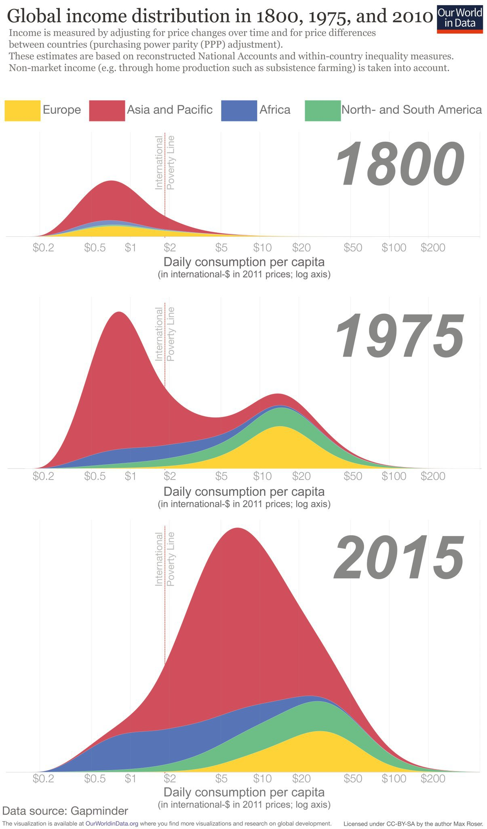
viz tank [a repository of data/info/knowledge visualisation solutions]
données bivariées quantitatives
income en $ per capita (par tête)
Approxiamtion du nbre de personnes
4 groupes « géographiques »
Seuil de pauvreté
The data are produced by Ola Rosling and published at the website of Gapminder.
https://www.gapminder.org/news/data-sources-dont-panic-end-poverty/
Regarding the construction of the data, Hans and Ola Rosling note the following here: "This graph is constructed by combining data from multiple sources. In summary, we take the best available country estimates for the three indicators: GDP per capita, Population and Gini (which is a measure of income inequality). With these numbers we can approximate the number of people on different income levels in every country. We then combine all these approximations into a global pile using the method described below under The Adjusted Global Income Scale."
Global Economic Inequality
Our World in Data, M. Roser (2016)
<https://ourworldindata.org/global-economic-inequality>
J.Y. Blaise, I. Dudek 2021

Slide 2
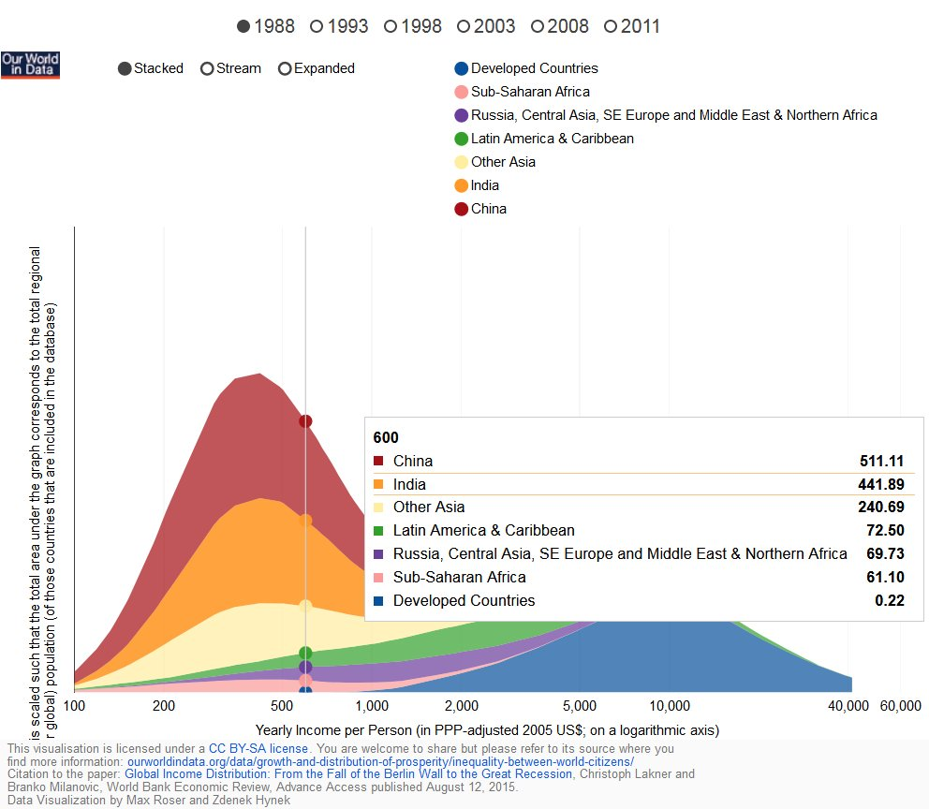
viz tank [a repository of data/info/knowledge visualisation solutions]
Version visualisation interactive,
Données pour l’année 1988
Global Economic Inequality
Our World in Data, M. Roser (2016)
<https://ourworldindata.org/global-economic-inequality>
J.Y. Blaise, I. Dudek 2021

Slide 3
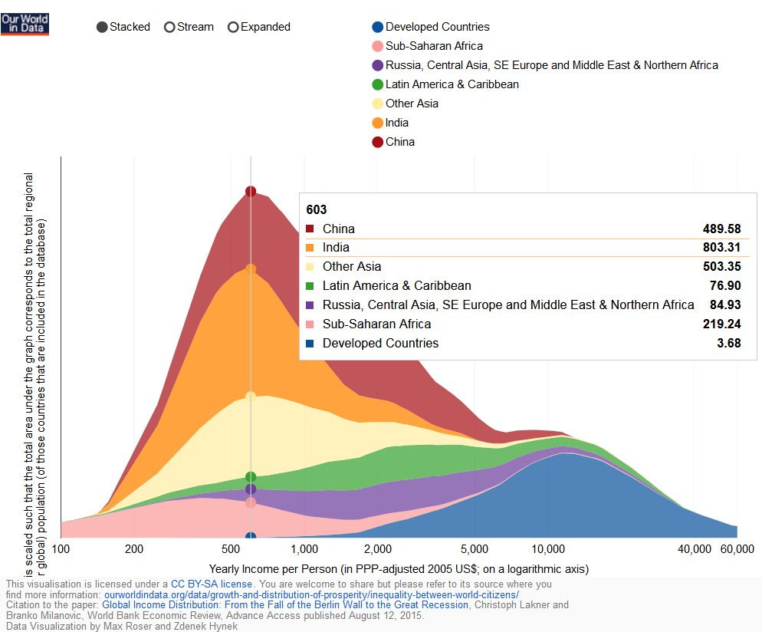
viz tank [a repository of data/info/knowledge visualisation solutions]
Version visualisation interactive,
Données pour l’année 1988
Global Economic Inequality
Our World in Data, M. Roser (2016)
<https://ourworldindata.org/global-economic-inequality>
J.Y. Blaise, I. Dudek 2021

