Slide 1
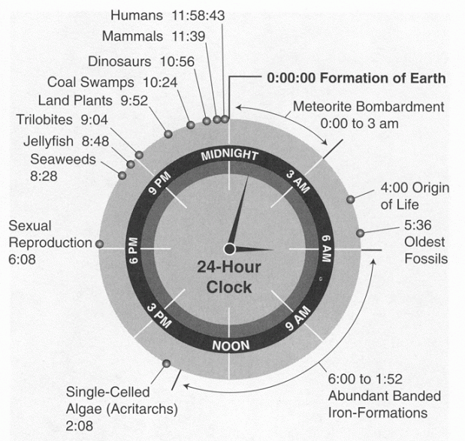
viz tank [a repository of data/info/knowledge visualisation solutions]
Métaphore visuelle 24-hour clock
… The semantics used by a visual metaphor are implicitly determined by the real-world equivalent
Règle appliquée ici ?
Flowing data.com (2012 )
Orig. www.geology.wisc.edu
<http://flowingdata.com/2012/10/09/history-of-earth-in-24-hour-clock/>
J.Y. Blaise, I. Dudek 2021

Slide 2
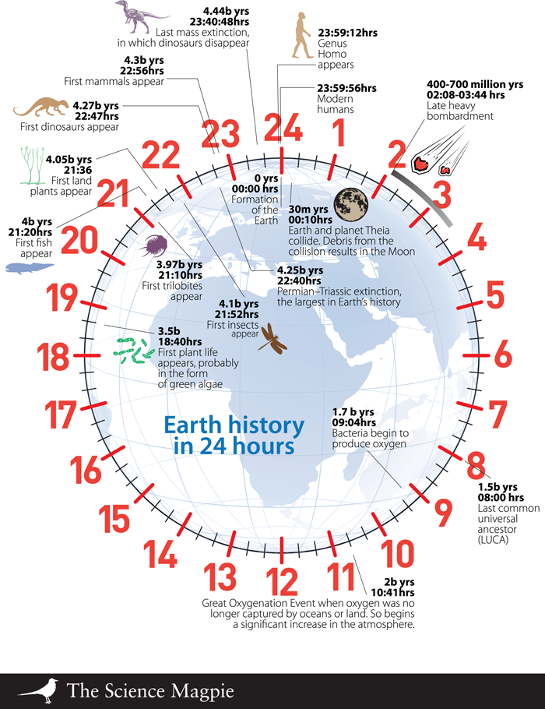
viz tank [a repository of data/info/knowledge visualisation solutions]
Métaphore visuelle 24-hour clock
… The semantics used by a visual metaphor are implicitly determined by the real-world equivalent
Règle appliquée ici ?
XX, Earth‘s History in 24-hours
Imgur community, 2014
<https://imgur.com/gallery/fL17Sjc>
J.Y. Blaise, I. Dudek 2021

Slide 3
viz tank [a repository of data/info/knowledge visualisation solutions]
Au passage, lecture de données contradictoires
<http://flowingdata.com/2012/10/09/history-of-earth-in-24-hour-clock/>
<https://imgur.com/gallery/fL17Sjc>
J.Y. Blaise, I. Dudek 2021

