Slide 1
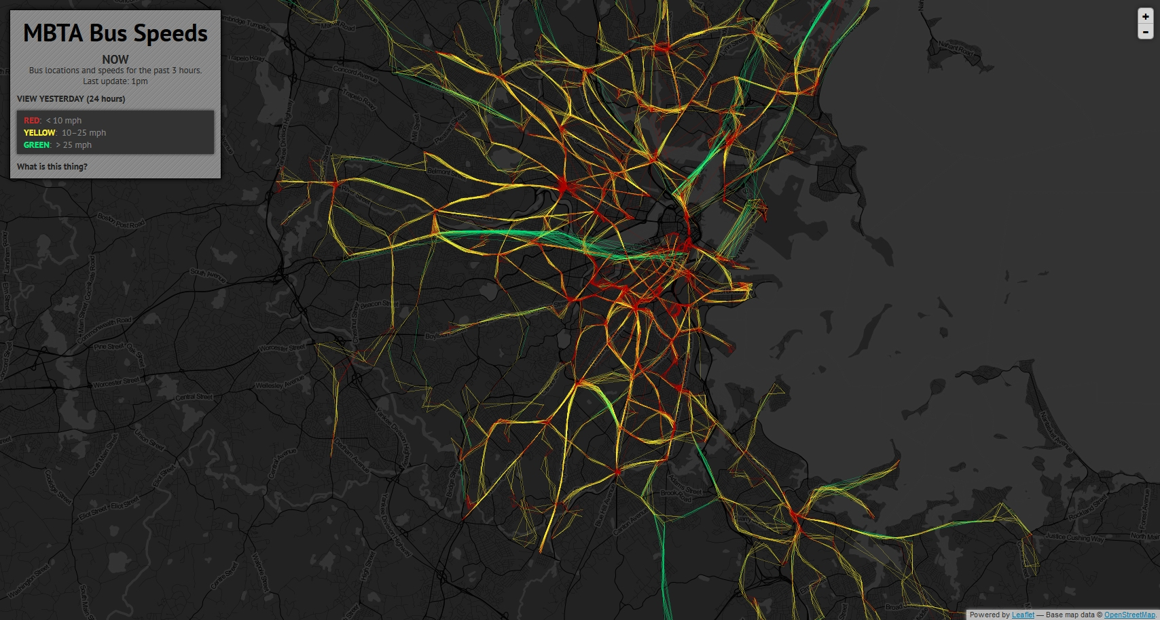
viz tank [a repository of data/info/knowledge visualisation solutions]
A map of MBTA bus locations and speeds, based on real-time GPS data. Each path is traced and colored along the way according to speed of travel, in a style inspired by some of Eric Fischer's maps.
Bostonography- MTBA Bus speeds
bostonography.com (2018)
<http://bostonography.com/bus/> (acc 16 07 2018)
J.Y. Blaise, I. Dudek 2021

Slide 2
viz tank [a repository of data/info/knowledge visualisation solutions]
Données temps réel collectées sur 3 heures puis projetées sur un fond cartographique
A map of MBTA bus locations and speeds, based on real-time GPS data. Each path is traced and colored along the way according to speed of travel, in a style inspired by some of Eric Fischer's maps.
Bostonography- MTBA Bus speeds
bostonography.com (2018)
<http://bostonography.com/bus/> (acc 16 07 2018)
J.Y. Blaise, I. Dudek 2021

Slide 3
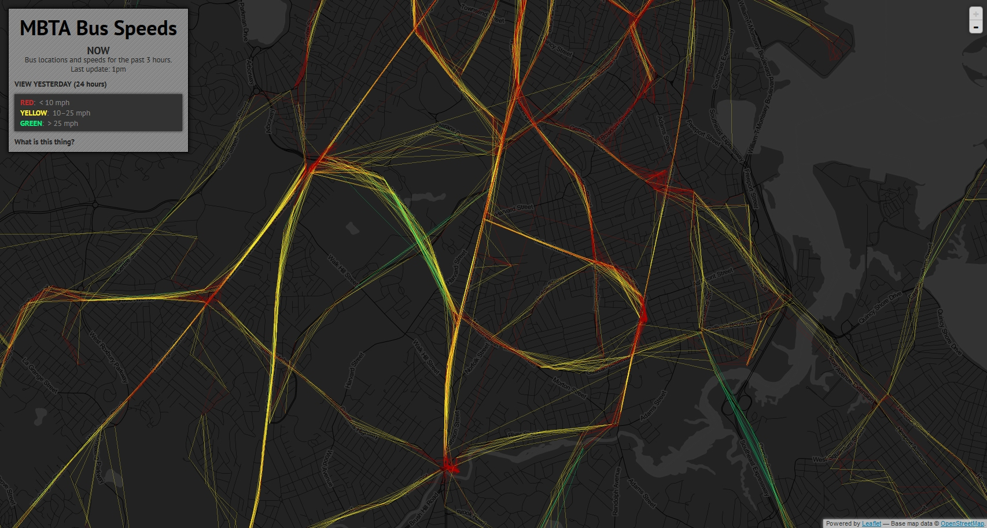
viz tank [a repository of data/info/knowledge visualisation solutions]
Motifs saillants
A map of MBTA bus locations and speeds, based on real-time GPS data. Each path is traced and colored along the way according to speed of travel, in a style inspired by some of Eric Fischer's maps.
Bostonography- MTBA Bus speeds
bostonography.com (2018)
<http://bostonography.com/bus/> (acc 16 07 2018)
J.Y. Blaise, I. Dudek 2021

Slide 4
viz tank [a repository of data/info/knowledge visualisation solutions]
Erreur?
A map of MBTA bus locations and speeds, based on real-time GPS data. Each path is traced and colored along the way according to speed of travel, in a style inspired by some of Eric Fischer's maps.
Bostonography- MTBA Bus speeds
bostonography.com (2018)
<http://bostonography.com/bus/> (acc 16 07 2018)
J.Y. Blaise, I. Dudek 2021

Slide 5
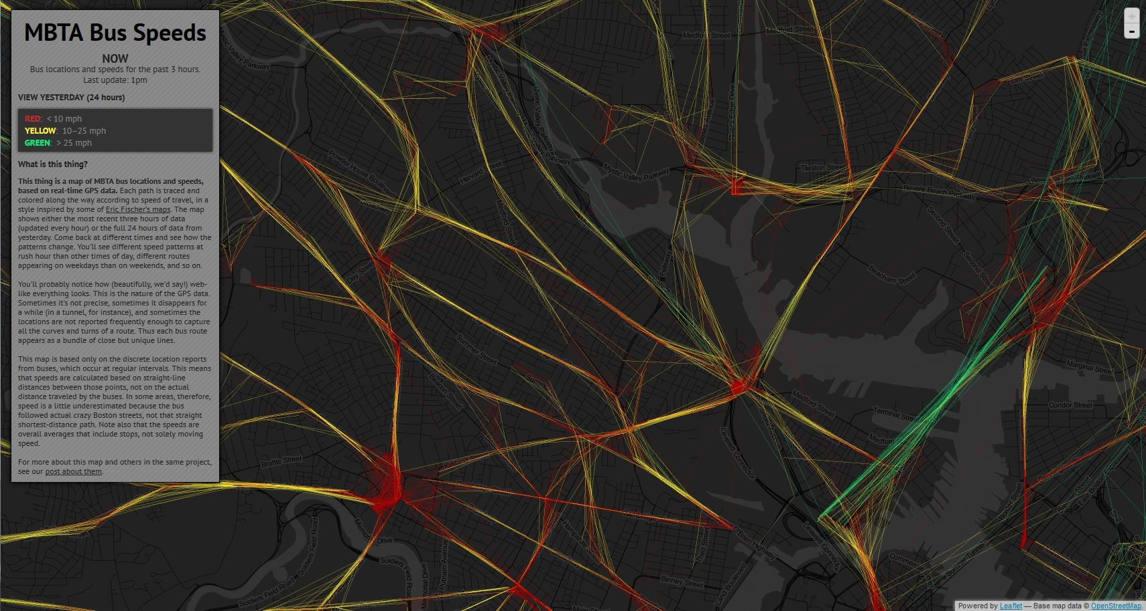
viz tank [a repository of data/info/knowledge visualisation solutions]
Variations au cours du temps, sur le même segment
A map of MBTA bus locations and speeds, based on real-time GPS data. Each path is traced and colored along the way according to speed of travel, in a style inspired by some of Eric Fischer's maps.
Bostonography- MTBA Bus speeds
bostonography.com (2018)
<http://bostonography.com/bus/> (acc 16 07 2018)
J.Y. Blaise, I. Dudek 2021

